Slide 1



Azure Machine Learning
pour la détection du SPAM
Florian Eiden
@fleid_bi
David Joubert
@dj_uber
#mstechdays techdays.microsoft.fr

Slide 2







Speakers
Florian Eiden @fleid_bi / fleid.fr La BI ça vous gagne
David Joubert @dj_uber / djuber.net La BI et les outils Microsoft
Cabinet de conseil IT et centre de formation spécialisé dans les technologies Microsoft et méthodes Agiles.
Data & Analytics
Application Development
Cloud & Integration
Collaboration & Content
ALM & Agilité

Slide 3
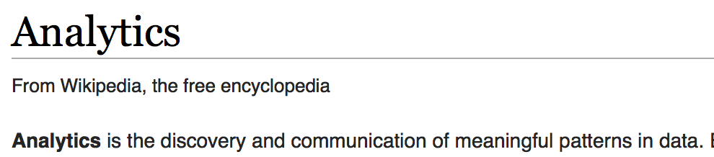
Analytics?
Depuis Wikipedia:
Sujet du jour
  Meaningful pattern / Motif intéressant : Mon email est-il un spam?

Slide 4
Précision du sujet
La problématique métier
Je suis un spammeur spécialiste du marketing, comment valider que ma pub mon contenu à forte valeur rentabilise le fichier client à l’origine douteuse atteigne un taux de hit maximal sur ma liste de prospects privilégiés
>> La question métier
Puis-je qualifier de manière automatique mes mailings en SPAM ou HAM?

Slide 5

Machine Learning
Des systèmes qui apprennent avec l’expérience
“Expérience” =
données passées + input humain
“
Delivering on one of the old dreams
of Microsoft co-founder Bill Gates:
Computers that can see, hear
and understand.
John Platt
Distinguished scientist at
Microsoft Research
”
Notes:
Machine Learning is a term that is not widely understood, perhaps you think of it as artificial intelligence or robotics or any number of things. It’s helpful to start with how we think of machine learning. Machine learning means computers that become smarter with experience. What do we mean by experience?
Experience is past data + human input. And that past data is often huge – the quantity of data is doubling about every 18 months and that’s only increasing from here. Computers can consider far more variables than a human making the same decision.
And what do we mean by human input? Human input takes two forms – the input of the user who is either communicating that the output is what they are looking to see or not. In the case that it’s not, the machine can either self-adjust to deliver better results moving forward or the advanced analytic developer or data scientist can make those changes to the model. Let’s look at examples from Microsoft over many years.

Slide 6


Azure Machine Learning
Analytics avancés, opérationnalisés
Data
Microsoft Azure Machine Learning
Des données au web service en quelques minutes
Clients
Devices, Applications, Dashboards
Cloud
API
HDInsight
SQL Server VM
SQL DB
Blobs & Tables
ML
Studio
Web
Local
Environnement de développement intégré de Machine Learning
Le modèle devient un web service
Fichiers locaux
Classeurs Excel
Autres données
sur le PC
Microsoft Azure Marketplace
Storage space
Monétisation de l’API
Problématique métier
Modélisation
Déploiement
Valeur Métier
Notes:
So what does that look like from an architectural perspective? Machine learning is a technology in which you work from business problem backwards. Let’s say I have an issue of customer churn. I don’t know why my best customers are leaving and I need to find out. I have things like Twitter/Facebook/Blog entries in HDInsight – Microsoft’s Hadoop implementation in the cloud – and it’s streaming in daily from the web. On premises I have my customer sales data and buying behavior.
I can then bring in the training set data from HDInsight and a subset of my on-premises customer data into the built-in storage space. I can then model against that training set in ML Studio – which is the playground for the data scientist or advanced analytic developer. In this space the implementer trains and tests the model until she is satisfied that the model will deliver the answer to the question of customer churn. Not only why the customers are departing, but predictive analytics to tell the company which ones are currently at risk based on past data. That way the sales and marketing departments can target those specific customers with the right activities to solve for why they’re leaving in the first place.
The implementer then literally pushes a “Yes” button in the tool to send the finished model into staging, with a flag on the Microsoft Azure portal letting the owner of the all-up portal experience know the model is ready to go. Again – this is a unique and differentiated experience with Azure ML – the only service that offers the ability to push a customized model to production this easily and quickly. Once pushed live, this is now surfaced as a web service which can run over any data, anywhere. If this is running over on-premises data, the data is never persisted in the cloud, so again the only data that must be in the cloud is the original training set, which can be anonymized and removed once the modeling is done for those customers with compliance/security concerns around data in the cloud.
This finished web service can now be called from the company dashboard, where the CMO can easily consume the results and advise the teams accordingly. And, as the company needs change, the implementer need only to revisit the model in ML Studio, adjust it and push it to staging again to literally have the model swap out underneath the live web service.
But what if the company doesn’t have an implementer in house? In that case, they can go right to the Azure Machine Learning Marketplace, where there are live hosted web services already existing to solve common problems such as this. They can be simply hooked up to apps, services and dashboards for this type of solution. This is also a value-add for companies and implementers looking to monetize their own machine learning solutions. Off azure.com/ml on Machine Learning Center there are detailed instructions on how to leverage this to create, monetize and scale your own ML offerings here.

Slide 7


Et donc pour nous… comment ça marche?
Azure ML - API
« We offer a new service that can revolutionize your process and allow you to reach… »
Modèle entrainé
"opérationnalisé"
SPAM!

Slide 8
Qui nécessite une mise en place
Les systèmes Machine Learning doivent apprendre
Azure ML
Modèle à entrainer
HDInsight
Jeux d’entrainement

Slide 9


Roadmap projet
Définir le pipeline data science
  Choisir l’algorithme, déterminer les traitements, prototyper - R
Entrainer le modèle
  Préparer les données avec HDInsight, Hadoop et Pig
  Concevoir le modèle grâce au Studio Azure ML
Opérationnaliser le modèle
  Déployer son modèle et publier l’API Azure ML
Le mettre à disposition des utilisateurs
  Consommer l’API Azure ML depuis Excel avec Power BI (Power Query)

Slide 10
Choisir l’algorithme
A partir d’un jeu de données qualifié, utiliser des attributs quantitatifs pour déterminer si un message est un spam ou pas (1 ou 0)
Apprentissage supervisé
Classification
> Logistic Regression
> SVM
> Decision Trees
> Neural Networks
> …

Slide 11
Classification: nourrir le modèle
Label | Attribut 0 | Attribut 1 | Attribut 2 | Attribut 3 | …
Spam | 2 |  | 1
Ham |  | 4 |  | 1
Ham |  | 3 | 1
Spam | 1 |  |  | 2
Ham |  | 1 | 2

Slide 12
A transposer dans notre cas
SPAM : « We offer a new service that can revolutionize your process and allow you to reach… »
Label | Attribut 0 | Attribut 1 | Attribut 2 | Attribut 3 | …
Spam | 2 |  | 1
Ham |  | 4 |  | 1
Ham |  | 3 | 1
Spam | 1 |  |  | 2
Ham |  | 1 | 2

Slide 13
L’intuition
SPAM : « We offer a new service that can revolutionize your process and allow you to reach… »
Label | offer | new | service | revolutionize | …
Spam | 1 | 1 | 1 | 1

Slide 14
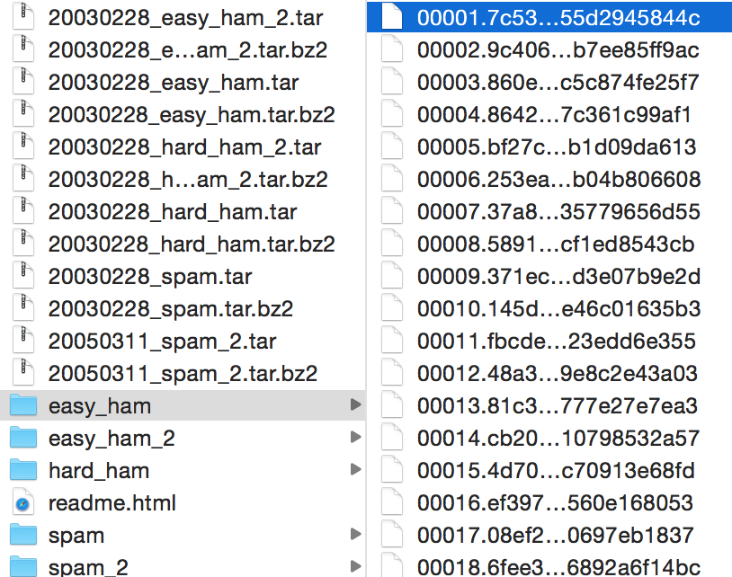
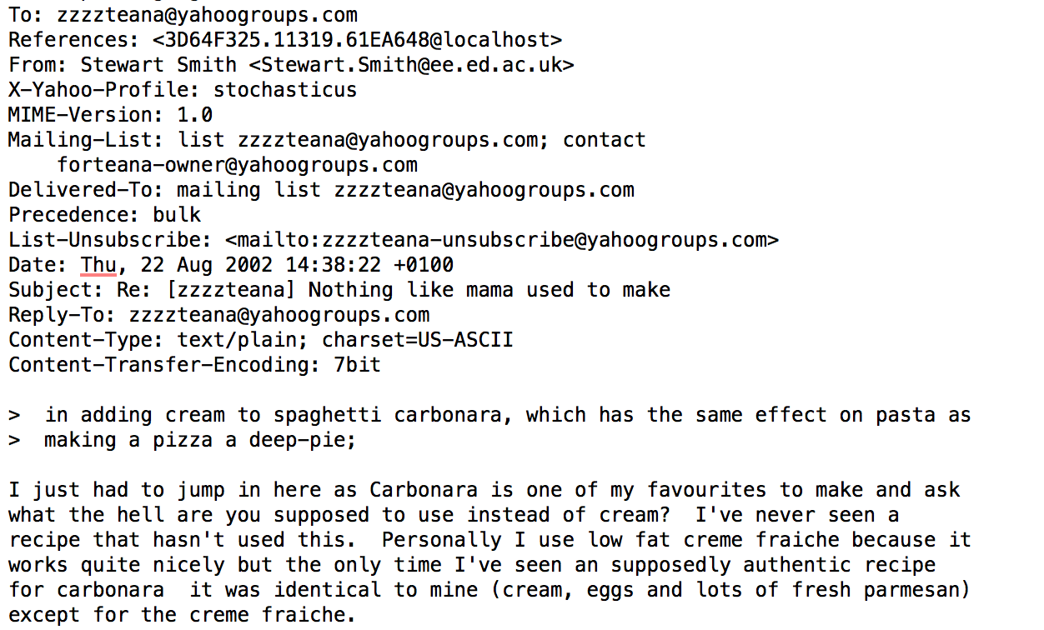
La réalité
SpamAssassin : 6000+ mails, texte non structuré

Slide 15
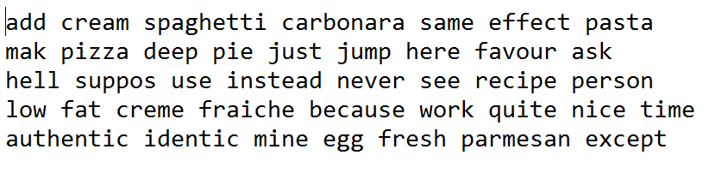
L’approche standard
Normalisation
url > #url
Email > #email
$,£,€ > #devise
Suppression des nombres, de la ponctuation, de stopwords, des balises HTML
Minuscules
Filtre des mots, longueur de 3 à 10
Stemming

Slide 16
Génération du corpus de référence
6000 mails > N mots de référence
On conserve les top 10’000 (paramètre de mon modèle)
  Ce sont les attributs à nourrir à l’algorithme
Label | Attribut 0 | Attribut 1 | Attribut 2 | Attribut 3 | … | Attribut 10000
Spam | 2 |  | 1 |  |  | 1
Ham |  | 4 |  | 1 |  | 1
Ham |  | 3 | 1
Spam | 1 |  |  | 2
Ham |  | 1 | 2 |  |  | 1
…
Spam |  |  |  |  |  | 1

Slide 17
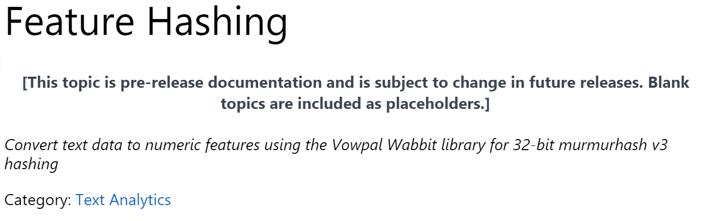
Implémentation Azure ML
Coup de poignard
  Pas de modules pour la Normalisation du texte
  A faire en amont : HDInsight / Pig
Coup de pouce
  Vowpal Wabbit : Algorithme de hashing intelligent pour la sélection des attributs (mieux que Top N)

Slide 18
Démos
1 – Normalisation du texte avec HDInsight
2 – Conception/entrainement du modèle avec Studio Azure ML
3 – Opérationnalisation avec le déploiement de l’API
4 – Consommation de l’API dans Excel avec Power Query

Slide 19
Aller plus loin
Approfondir
  Ajouter du volume, adapter le traitement pour le français
  Ajouter des attributs (exploiter l’entête!)
  Optimiser les paramètres des algorithmes
  Online Machine Learning
  …
Apprendre
  Documentation Azure ML, et les samples Azure ML disponibles directement dans le studio
  Source SpamAssassin : http://spamassassin.apache.org/publiccorpus/
  Coursera : Machine Learning par Andrew Ng (ex 6 – spam detection with SVM)
  Coursera : Reproducible Research par Roger D. Peng (Week 1 – Structure of a Data Analysis)
  Classifying Emails as Spam or Ham using RTextTools, Dennis Lee (blog)
  Pig as Duct Tape, Part Three: TF-IDF Topics with Cassandra, Python Streaming and Flask (Hortonworks)
  AzureML Web Service Scoring with Excel and Power Query, Rui Quintino (blog)

Slide 20
Aller plus loin : pratiquer!
Microsoft Azure
Microsoft Power BI
Pour tous
Un mois d’essai offert
150€ de ressources offertes
Sans engagement
http://azure.com
A télécharger
En fonction de vos licences
Potentiellement déjà inclus!
http://www.microsoft.com/en-us/powerBI/support/default.aspx
NB : la Preview concerne le nouveau Power BI Dashboard, pas Power Query montré ici (add-in Excel)
Pour les abonnés MSDN
Activez vos bénéfices Azure jusqu’à 115€ de ressources mensuelles offertes
http://aka.ms/azurepourmsdn

Slide 21
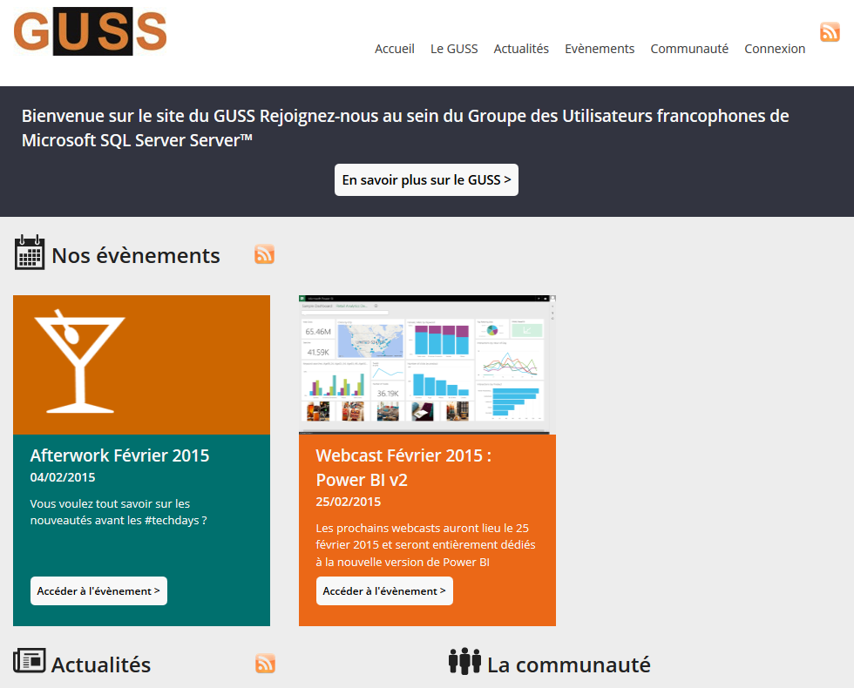
Aller plus loin: la communauté
GUSS
Groupe des Utilisateurs
    1000+ membres
    Nombreux événements
      Journées SQL Server
      SQLSaturday
    Chaîne Youtube: GUSS_FRANCE
    France chapter du PASS
http://guss.pro

Slide 22
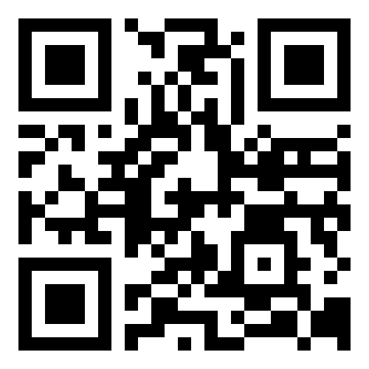
Notez les sessions!
http://notes.mstechdays.fr
En navigant depuis le site mobile mstechdays.fr
Via le QRCode (?)

Slide 23
#mstechdays techdays.microsoft.fr
© 2015 Microsoft Corporation. All rights reserved.

